Slide 1
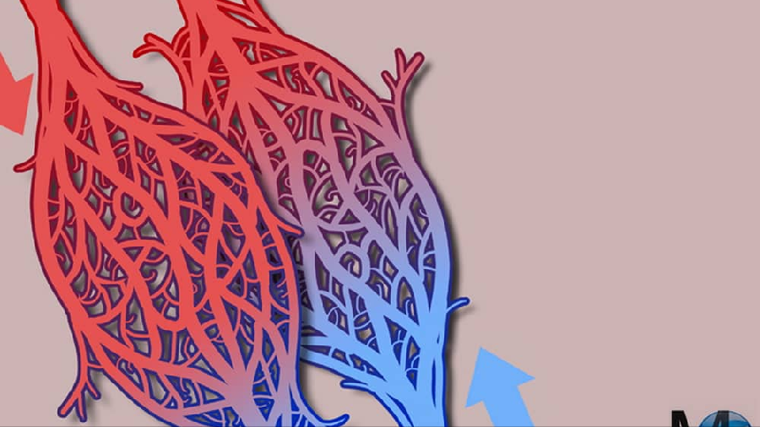
RETE MIRABILE AND THE COUNTERCURRENT MECHANISMS
GROUP 9

Slide 2
CONTENT
RETE MIRABILE
FUNCTION
EXAMPLES OF RETE MIRABILE IN BIOLOGICAL SYSTEMS
COUNTER CURRENT MECHANISM
EXAMPLES OF COUNTER CURRENT MECHANISM
THE RELATIONSHIP BETWEEN RETE MIRABLE AND COUNTER CURRENT MECHANISMS
CONCLUSION
REFERENCES

Slide 3
RETE MIRABILE
Rete mirabile are two Latin words which means wonderful net.
It is a complex network of blood vessels found in some animals that facilitates the flow or exchange of gases or heat.
The key principle of the Rete mirabile is that it allows blood (or gas) flowing in opposite directions in adjacent vessels to exchange heat or gases efficiently
Rete mirabile structures are found in vertebrates and in various parts of the body, including the brain, the gills of fish, the legs of some birds, and the flippers of marine mammals.

Slide 4
FUNCTION OF RETE MIRABILE
Responsible for maintaining the homeostasis of the body by regulating the exchange of substances between adjacent blood vessels.
4

Slide 5
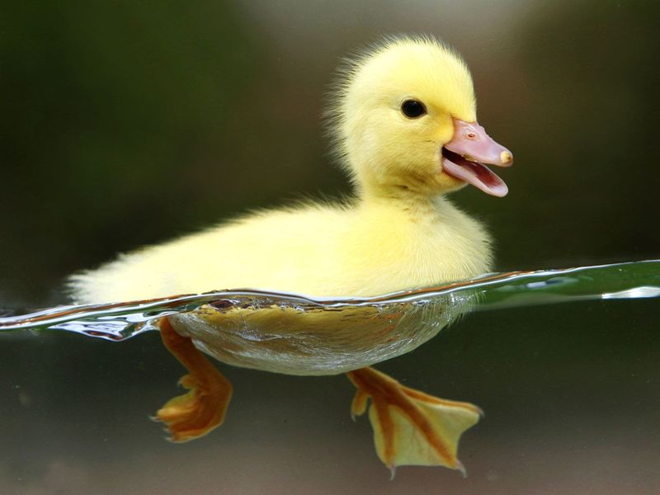
BIRDS
EXAMPLES OF RETE MIRABILE
In birds with webbed feet, the rete mirabile reduces heat loss and aids in regulating body temperature
The design also stops the feet from overheating in hot weather by lowering the arterial blood's temperature before it reaches the extremities.

Slide 6
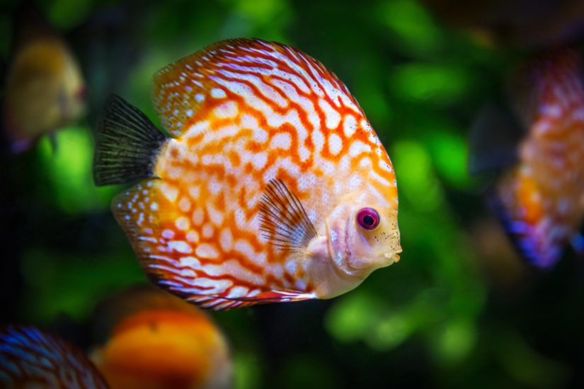
FISHES
EXAMPLES OF RETE MIRABILE
Allows for an increase in muscle temperature in regions where this network of vein and arteries is found
The fish is able to thermoregulate certain areas of its body.
Additionally, this increase in temperature leads to an increase in basal metabolic temperature

Slide 7
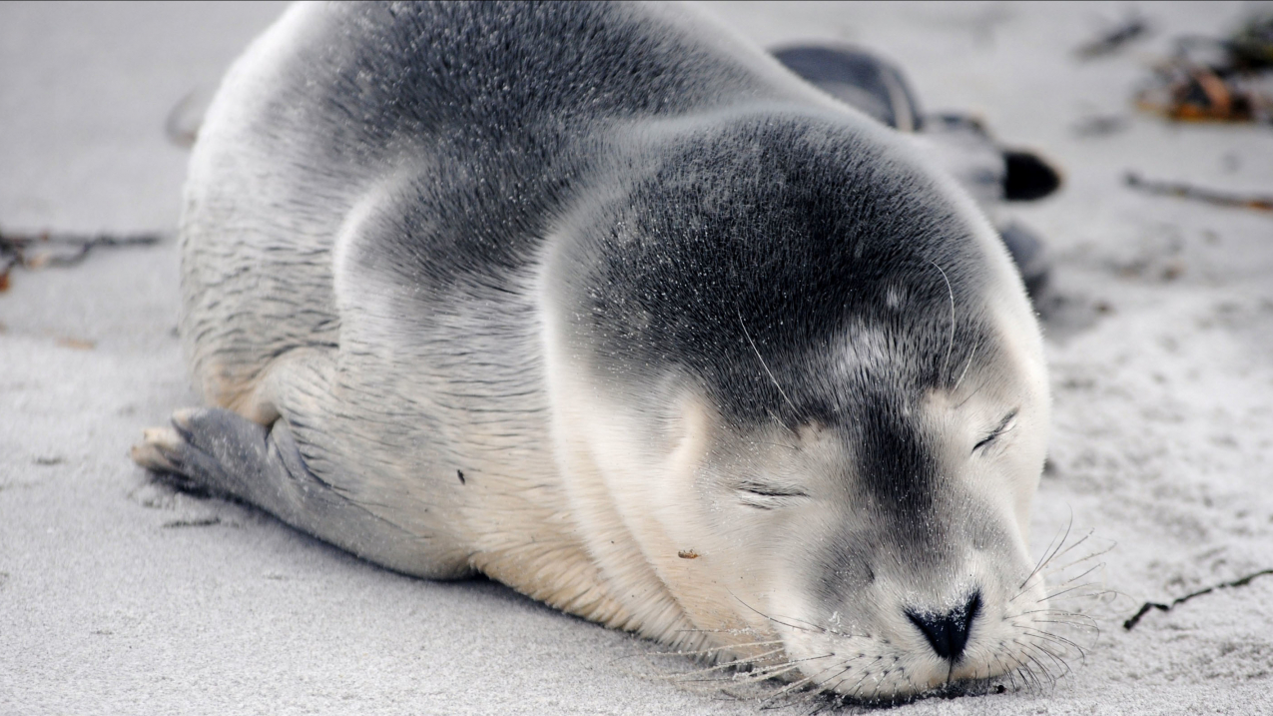
MAMMALS
EXAMPLES OF RETE MIRABILE
In mammals that burrow, dive or have arboreal lifestyles it helps in clinging with the limbs for lengthy periods.
In marine mammals, the rete mirabilis in their flippers helps to regulate blood flow and prevent heat loss when swimming in cold water.
In the neck of the dog, the rete mirabile protects the brain when the body overheats during hunting; the venous blood is cooled down by panting before entering the net.

Slide 8
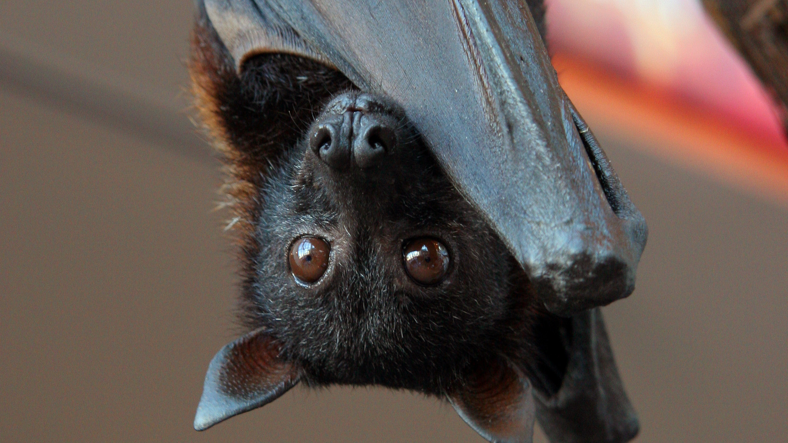
BATS
EXAMPLES OF RETE MIRABILE
Rete mirabilis in their wings helps to regulate blood flow and maintain body temperature during flight.

Slide 9
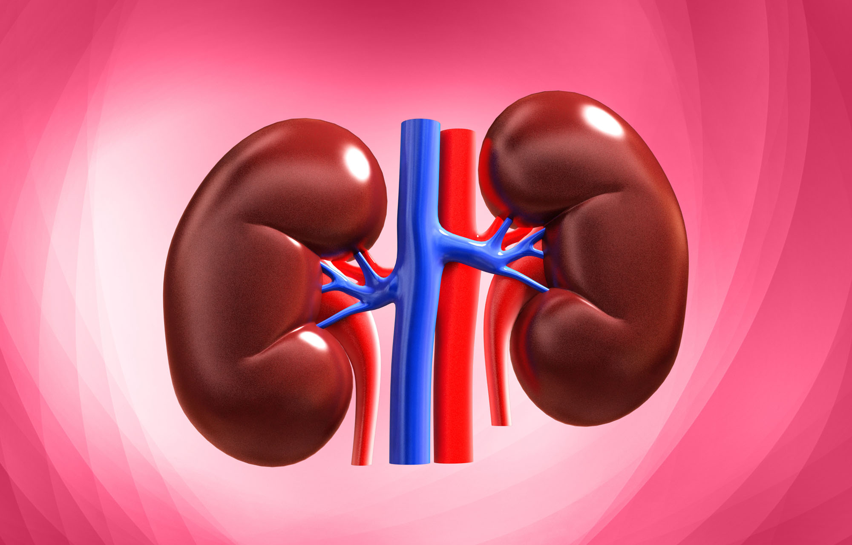
Human kidney
EXAMPLES OF RETE MIRABILE
Rete mirabilis in its medulla helps to maintain a concentration gradient between the blood and urine, which is important for the production of concentrated urine.

Slide 10
Countercurrent mechanisms
These are biological processes that involve the flow of substances such as ions, gases or liquids in opposite directions.
It occurs widely in nature, especially in mammalian organs.

Slide 11
GAS EXCHANGE IN BIRD LUNG
Air sacs and unidirectional airflow in a bird's respiratory system combine to provide a countercurrent gas exchange mechanism that maximizes oxygen uptake and carbon dioxide elimination.
EXAMPLES OF COUNTERCURRENT MECHANISMS

Slide 12
EXCHANGE IN FISH GILLS
Facilitates efficient oxygen uptake and carbon dioxide elimination.
Water flows over the gills in one direction, while blood flows through the gill capillaries in the opposite direction.
This allows for a concentration gradient of oxygen and carbon dioxide between the water and the blood, maximizing gas exchange.
EXAMPLES OF COUNTERCURRENT MECHANISMS

Slide 13
EXCHANGE IN THE KIDNEYS
Aids in water conservation and urine concentration.
It involves a countercurrent fluid flow in the loop of Henle, generating the essential osmotic gradient for water reabsorption.
EXAMPLES OF COUNTERCURRENT MECHANISMS

Slide 14
RELATIONSHIP BETWEEN RETE MIRABLE AND COunter CURRENT MECHANISMS
The counter current reaction works by establishing a concentration gradient between adjacent blood vessels.
For example, in the rete mirabilis of fish gills, the warm, oxygen-rich blood from the heart flows in one direction, while the cool, oxygen-poor water flows in the opposite direction.
This allows for the efficient transfer of oxygen from the water to the blood, as the concentration of oxygen in the water is always higher than the concentration of oxygen in the blood.

Slide 15
CONCLUSION
Overall, rete mirabilis is an important adaptation that allows organisms to survive and thrive in their respective environments.

Slide 16
REFERENCES
Thermoregulation in marine mammals by D. P. Costa, in Comparative Biochemistry and Physiology Part A: Physiology, vol. 101,1992.
The countercurent multiplier system by W. H. Dantzler, in American Journal of Physiology-Renal Physiology, vol. 299, 2010
Proctor, Noble S.; Lynch, Patrick J. (1993). Manual of Ornithology. Yale University Press. ISBN 0300076193.
Ritchison, Gary. "Avian osmoregulation Urinary System, Salt Glands, and Osmoregulation". Retrieved 16 April 2011.
Carey, F.G., Teal, J.M., and Kanwisher, J.W. (1967). "Temperature and heat production in the swimming musculature of fast tuna and the 'tuna rete'." Comparative Biochemistry and Physiology, 22(3), 721-741. doi:10.1016/0010-406X(67)90742-5
Carpenter, F.L., and Hixon, M.A. (1988). "Heat exchange from the avian foot: the rete mirabile and countercurrent heat exchange system." Condor, 90(1), 100-114. doi:10.2307/1368434
Graham, J. B., & Baird, T. A. (1981). The gill of fishes: options in the aquatic environment. Environmental Biology of Fishes, 6(2), 167-184. doi:10.1007/BF00002553

Slide 17


